Slide 1
PerfTest: Application Monitoring
Yoonki Song
Last Updated: Sep. 4, 2009

Slide 2
Application Monitoring
Prerequisites

Slide 3
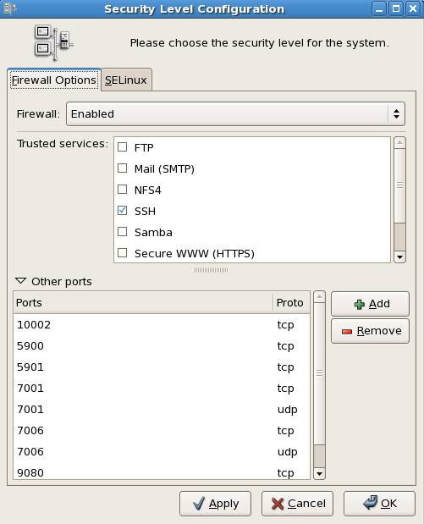
Ports
10002
5900
5901
9080
9090
system-config-securitylevel

Slide 4
Trace data Collection Sequence with Instrumentation
Client
Server
Start IBM HTTP Server
Start Instrumentation
instrumentServer.sh …
Start Agent Controller
Start DCI
Start WebSphere Application Server
6. Start DCI
7. Start Recording and Launching Test/Schedule via RPT
/root/perftest/start.sh
Output: Trace data (a)
Notes:
3451 <- x
4513 <-

Slide 5
Trace data Collection Sequence without Instrumentation
Client
Server
Start WebSphere Application Server
Start IBM HTTP Server
Use TPTP to collect trace data
6. Our plug-in analyzes trace data (b)
Output: Trace data (b)

Slide 6
File extensions
Extension | Description
executiondlr
Trcadlr
Trcaxmi | Trace Agent
Trciovxmi
Trcmxmi | Trace Monitor
Trcnxmi | Trace Node
Trcpxmi | Trace Process
trcxml

Slide 7
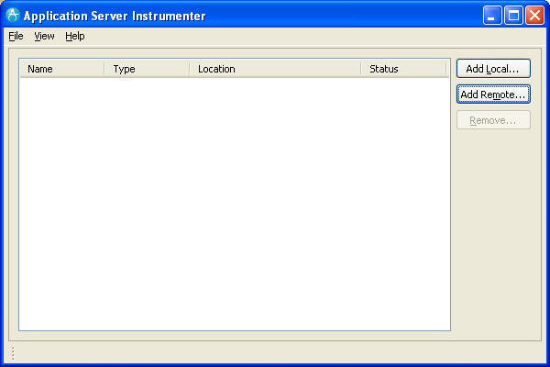
Application Server Instrumenter (ASI)

Slide 8
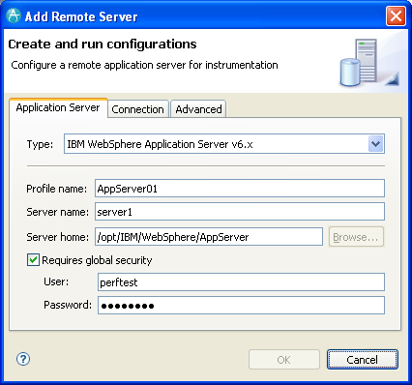
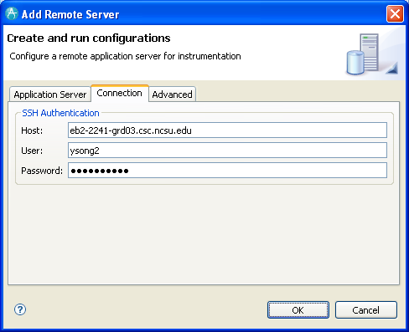
Application Server Instrumenter (ASI)

Slide 9
Application Server Instrumenter (ASI)
Application Server Tab
Type: IBM WebSphere Application Server v6.x
Profile name: AppSrv01
Server name: eb2-2241-grd03.csc.ncsu.edu
Server home: /opt/IBM/WebSphere/AppServer
User: perftest
Password: perftest
Connection Tab
Host: eb2-2241-grd03.csc.ncsu.edu or ldap.ncsu.edu (?)
User: ysong2
Password: <?>

Slide 10
…
{WAS_PROFILE_HOME}/config/cells/{cell_name}/nodes/{node_name}/servers/{server_name}
/opt/IBM/WebSphere/AppServer/profiles/AppSrv01/config/cells/eb2-2241-grd03Node01Cell/nodes/eb2-2241-grd03Node01/servers/server1/server.xml
/opt/IBM/WebSphere/AppServer/profiles/AppSrv01/config/cells/eb2-2241-grd03Node01Cell/nodes/eb2-2241-grd03Node01/servers/server1/variables.xml
{WAS_PROFILE_HOME}/config/cells/{cell_name}
/opt/IBM/WebSphere/AppServer/profiles/AppSrv01/config/cells/eb2-2241-grd03Node01Cell/pmirm.xml

Slide 11
…
/opt/IBM/SDP/DCI/rpa_prod/tivoli_comp/app/instrument/6.103.0000/appServers/server1_101/config

Slide 12
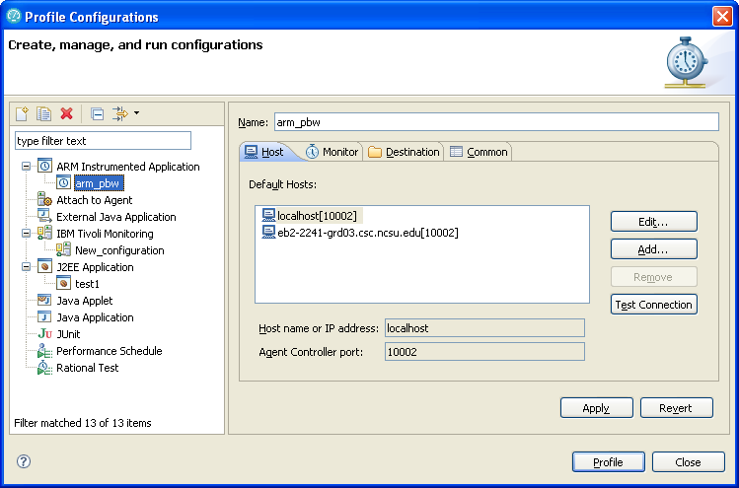
Profile Configurations

Slide 13
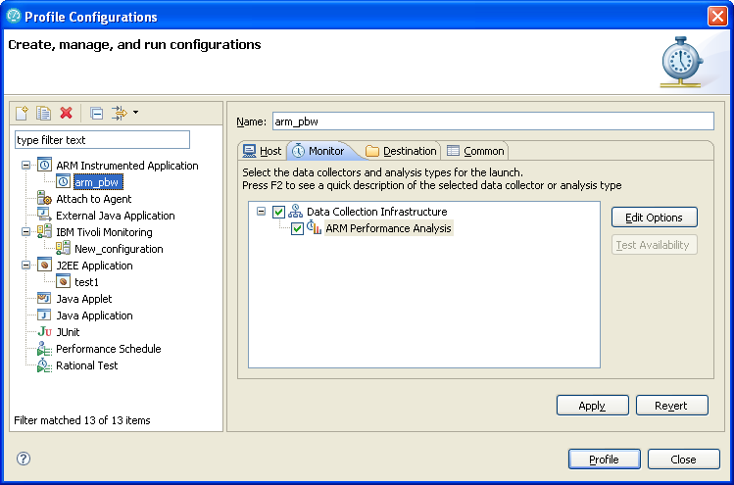
Profile Configurations (Cont’d)

Slide 14
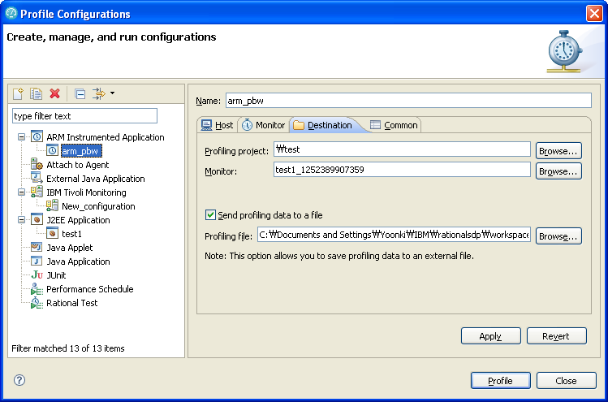
Profile Configurations (Cont’d)

Slide 15
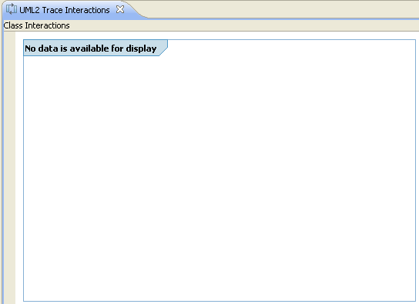
Trouble Shooting
No data available for display

Slide 16
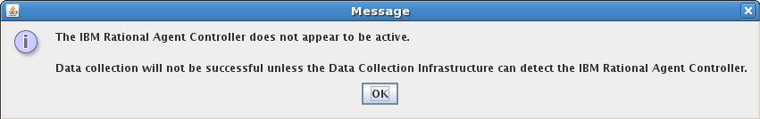
Trouble Shooting

Slide 17
Trouble Shooting

Slide 18
Application Monitoring
Part 1: Configuring the environment

Slide 19
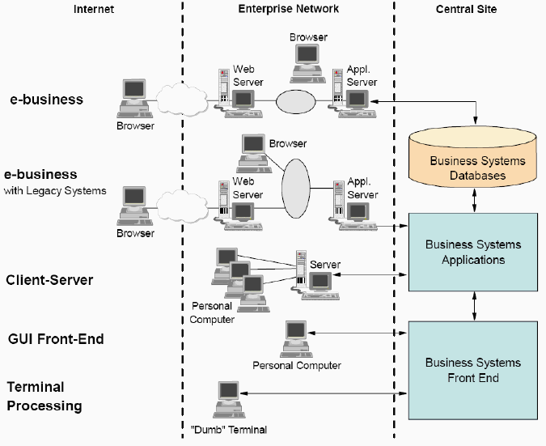
Distributed Environment Complexity

Slide 20
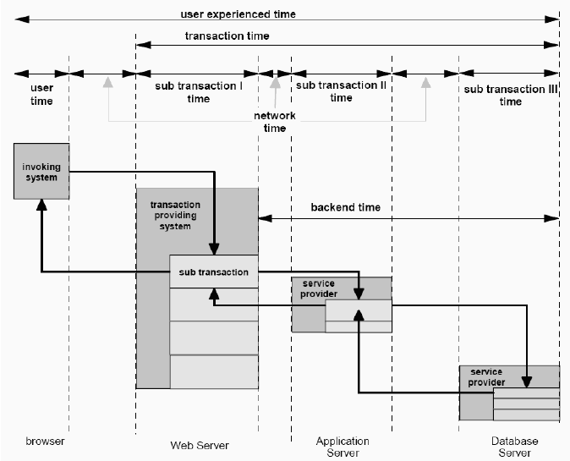
Transaction Breakdown

Slide 21
Application Monitoring
Part 2: Enabling Real-time Monitoring

Slide 22
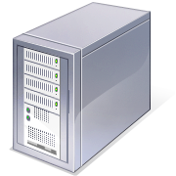

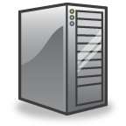
Server:
eb2-2241-grd03.csc.ncsu.edu
(152.14.90.72)
WSAS

Slide 23


Client
Ideally, ASI should be run on the both side. The server side (Recommendation)
Server
WebApp
RPT 8
Before using RPT, web apps should be instrumented.
WebSphereAppSvr6.1
ASI / DCI
ASI / DCI
This information is generated by JVMPI/TI, not ARM
This information is generated by ARM
Analyze to identify how many transactions and method invocation trees
[Todo]
Evaluation, Analysis, and Visualization for XML file, that contains transactions, generated by TPTP
[Analysis]
“doGet” – the start of transaction

Slide 24
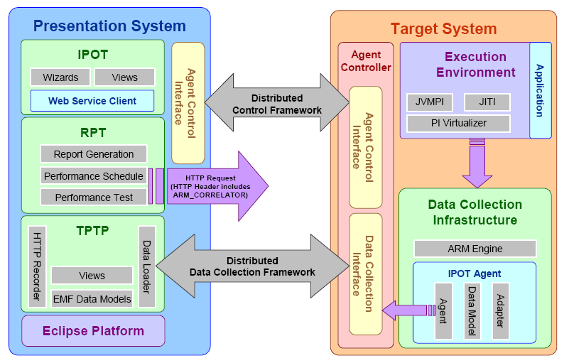
System Architecture using the Data Collection Architecture
5
1
ARM-instrumented application (e.g., PlantsByWebSphere)
2
5
3
4

Slide 25
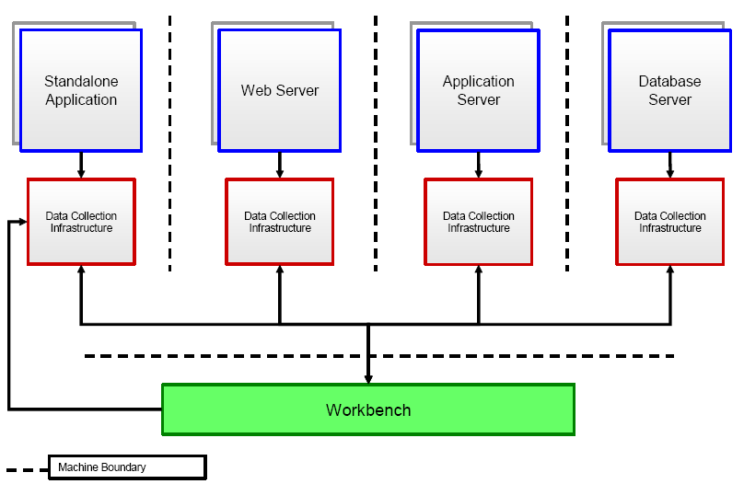
Data Collection Infrastructure for a Distributed Environment

Slide 26
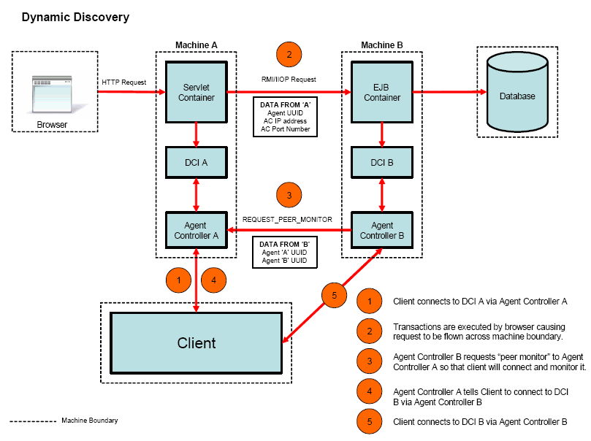
Dynamic Discovery Process

Slide 27
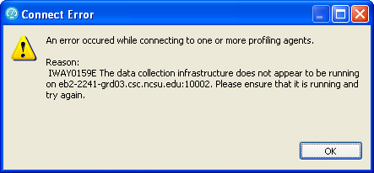
Trouble Shooting
IWAY0159E (http://publib.boulder.ibm.com/infocenter/rpthelp/v7r0m0/index.jsp?topic=/com.ibm.rational.test.lt.doc/topics/uiway0159e.html)

Slide 28
Application Monitoring
Part 3: Importing data from IBM Tivoli database products

Slide 30
References
Install WebSphere Application Server V6.0 for Linux on POWER (http://www.ibm.com/developerworks/systems/library/es-webapp/index.html)
WebSphere Application Server 6.1 Headless Install (http://bishop.camp.clarkson.edu/wiki/en/WebSphere_Application_Server_6.1_Headless_Install)

Slide 31
References
Using IBM Rational Performance Tester: Application Monitoring Part 1, Configuring your environment (http://www.ibm.com/developerworks/rational/library/07/0515_patel/index.html)
Using IBM Rational Performance Tester: Application Monitoring Part 2, Enabling real-time monitoring (http://www.ibm.com/developerworks/rational/library/07/0515_patel2/index.html)
Using IBM Rational Performance Tester: Application monitoring, Part 3: Importing data from IBM Tivoli database products (http://www.ibm.com/developerworks/rational/library/07/0605_patel/index.html)

